Slide 1


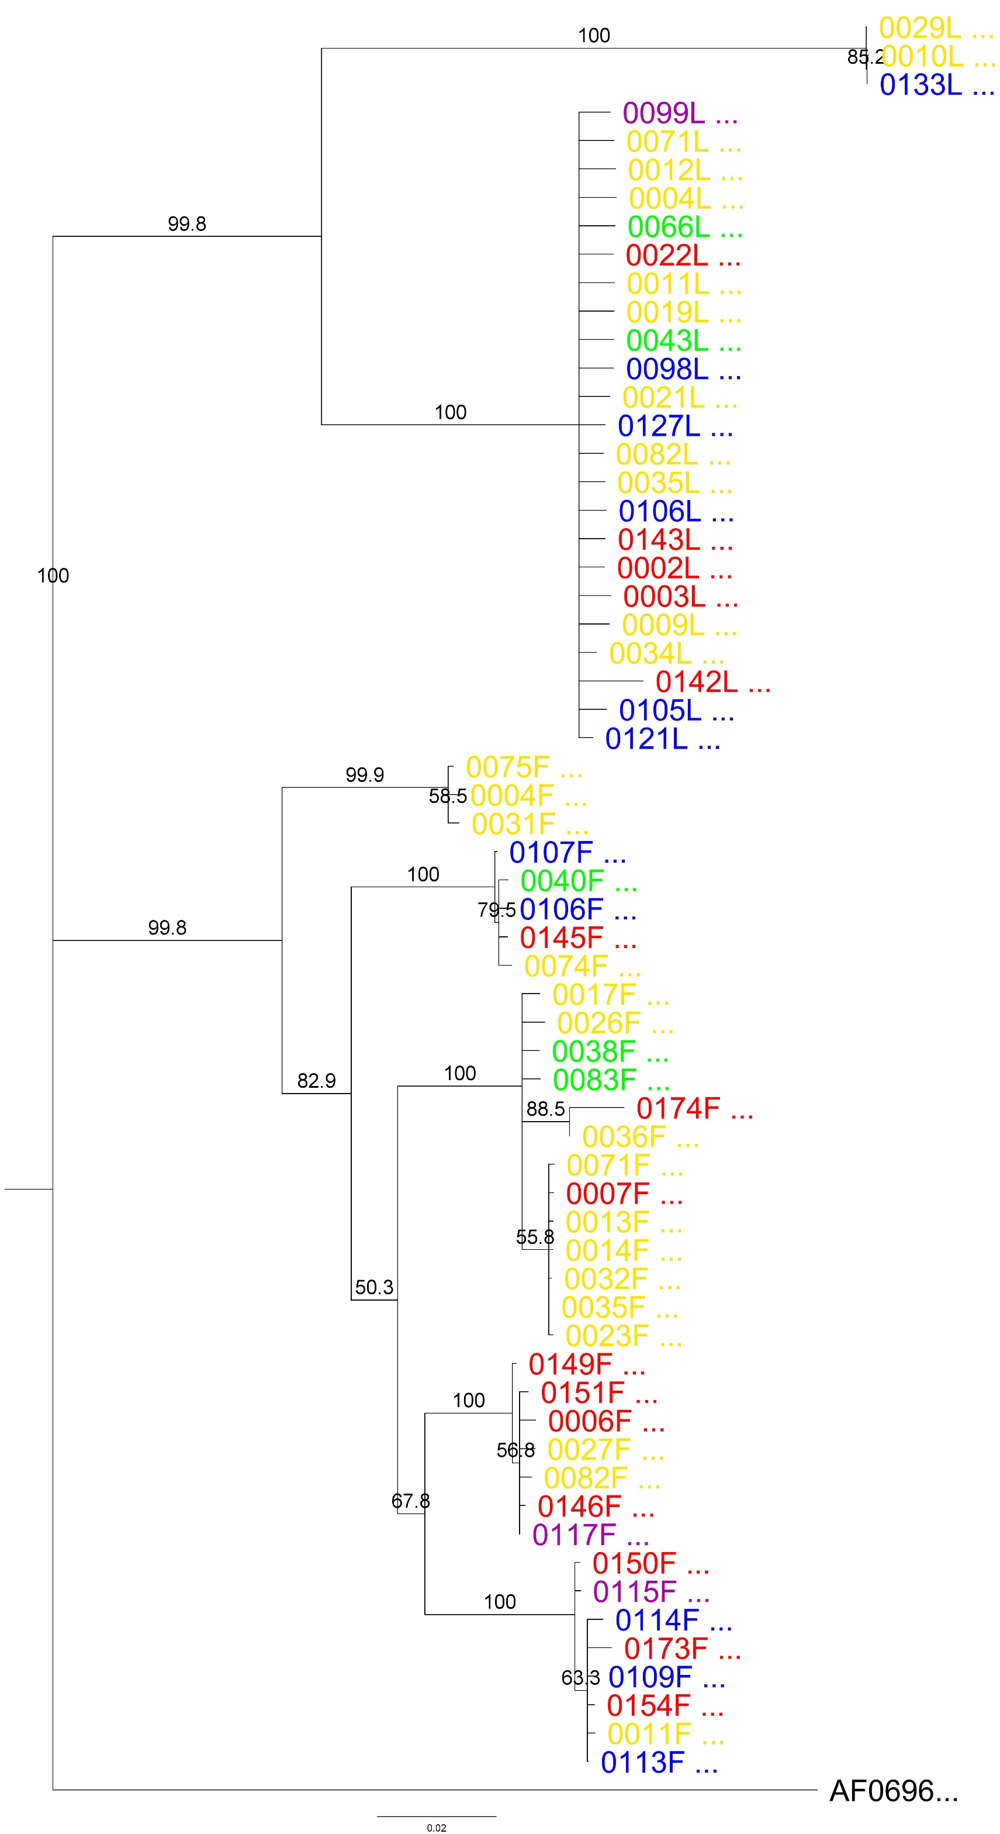
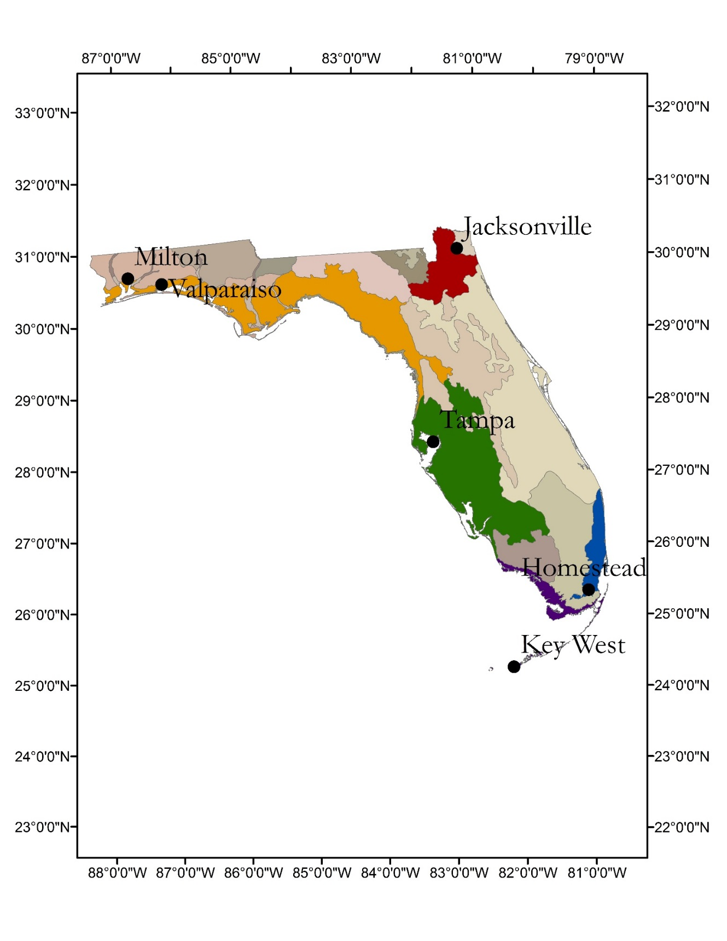
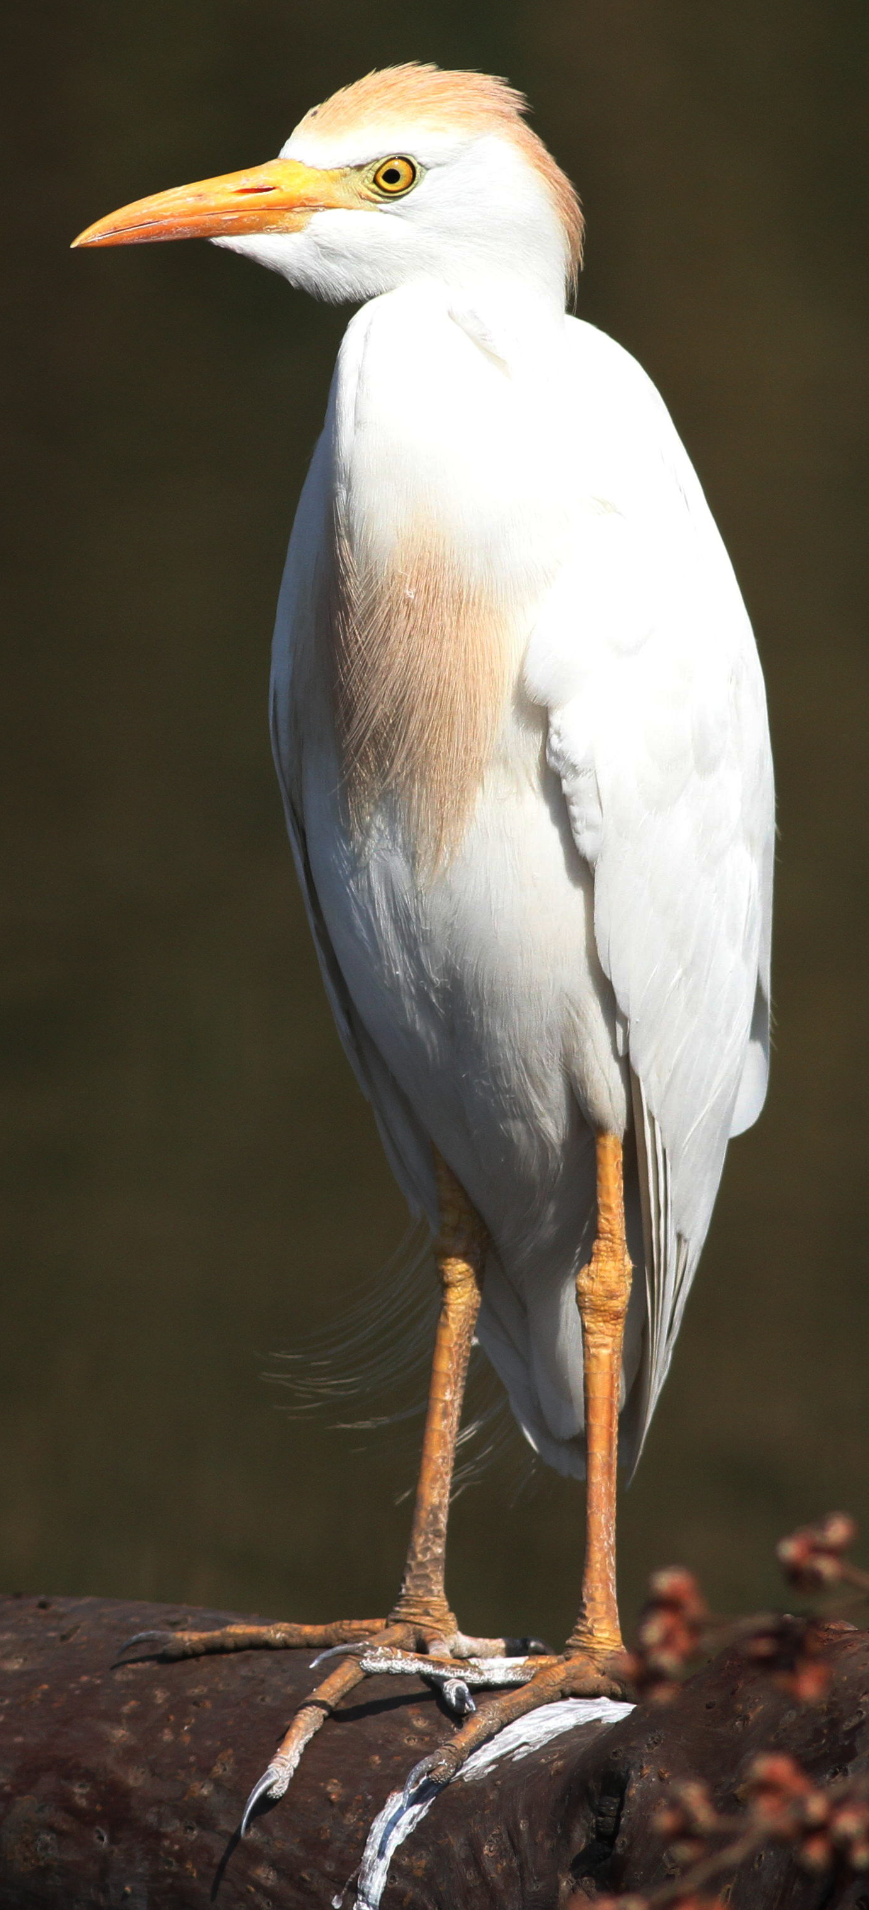
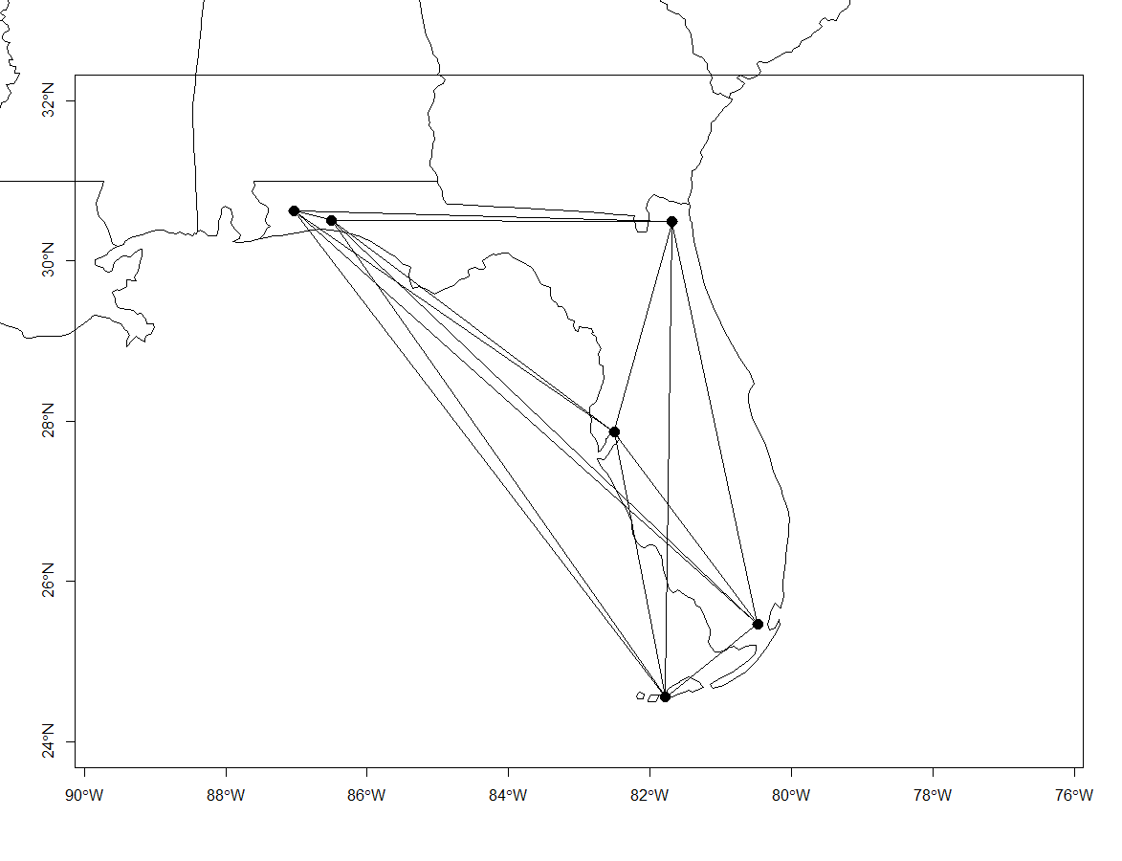
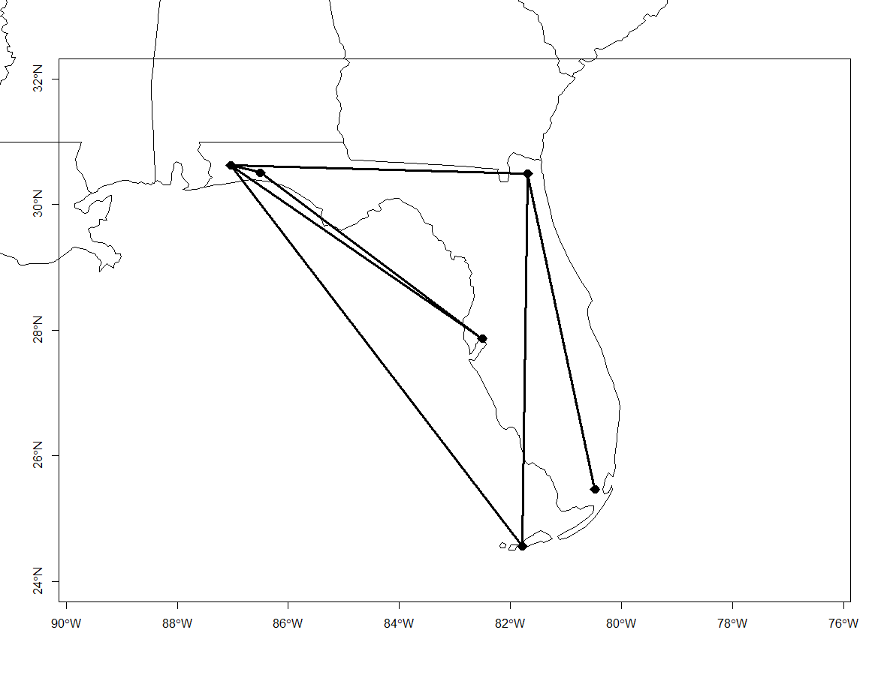
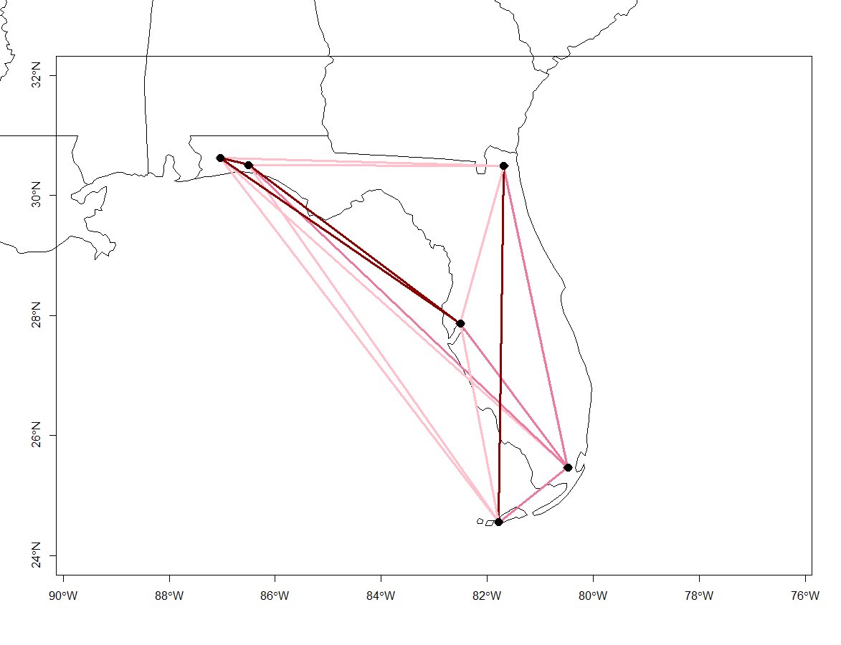
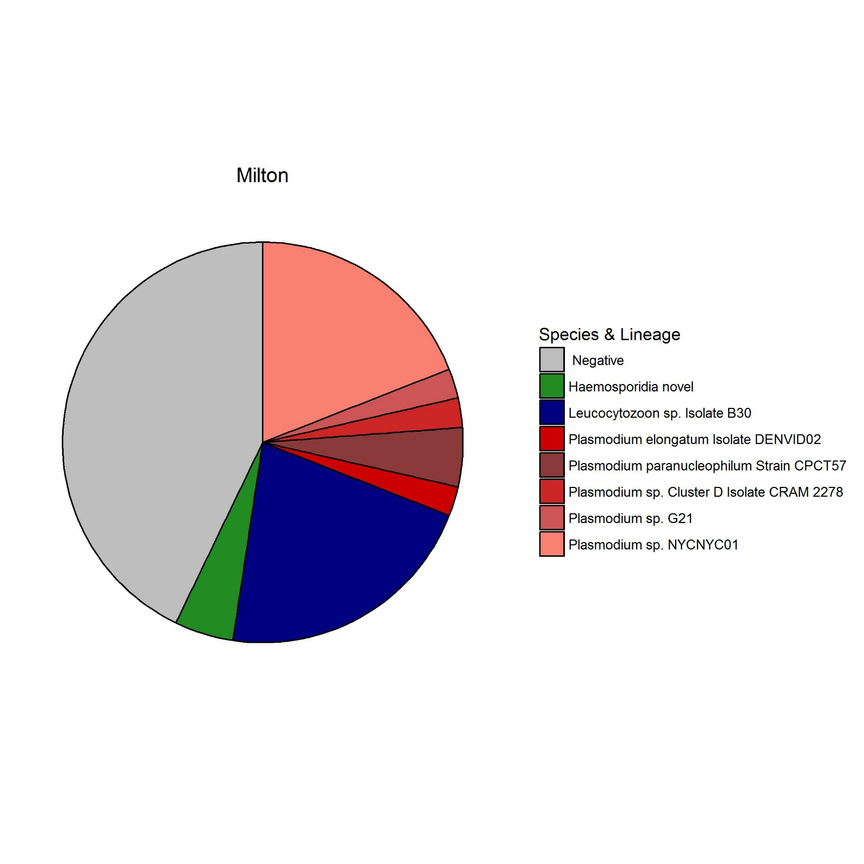
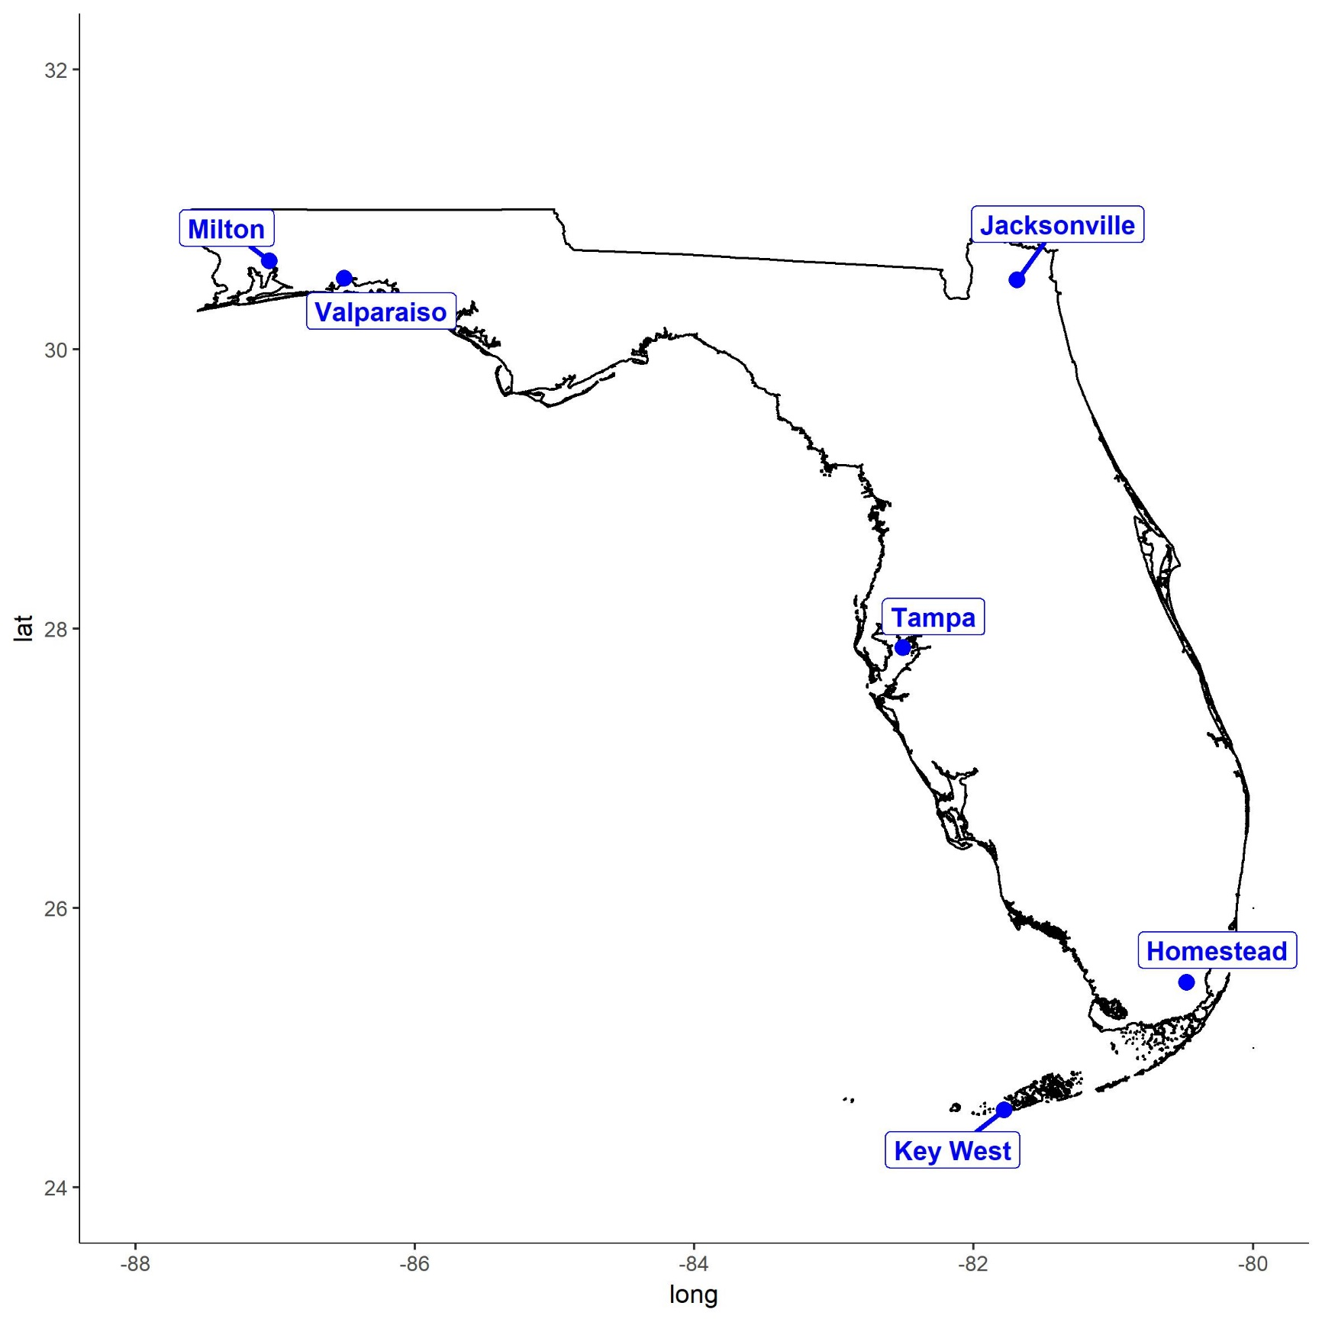
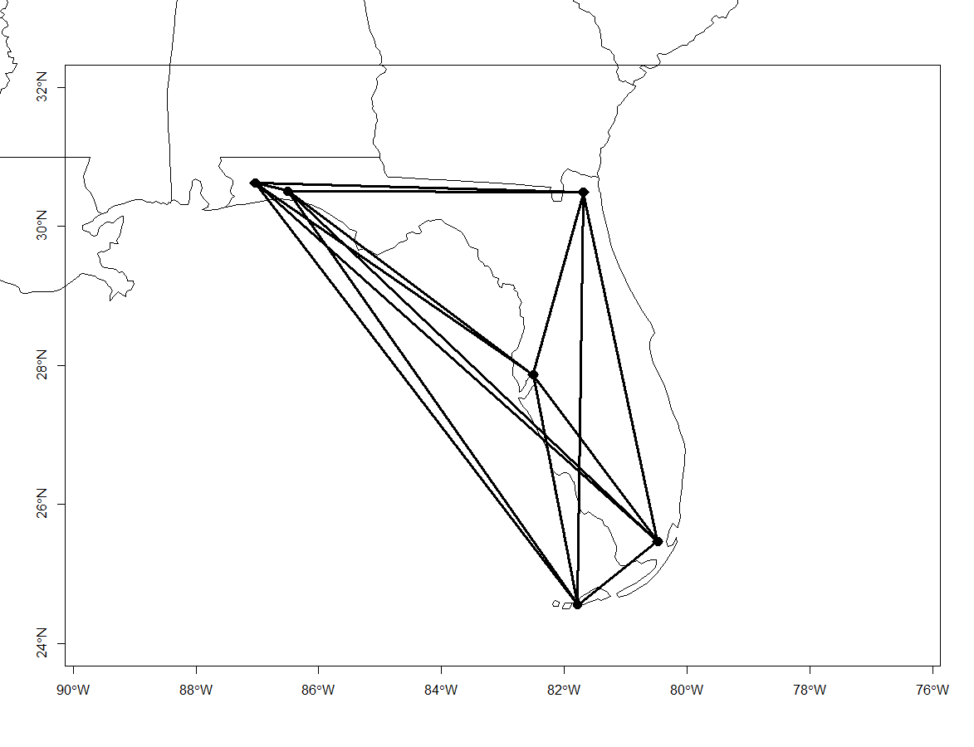
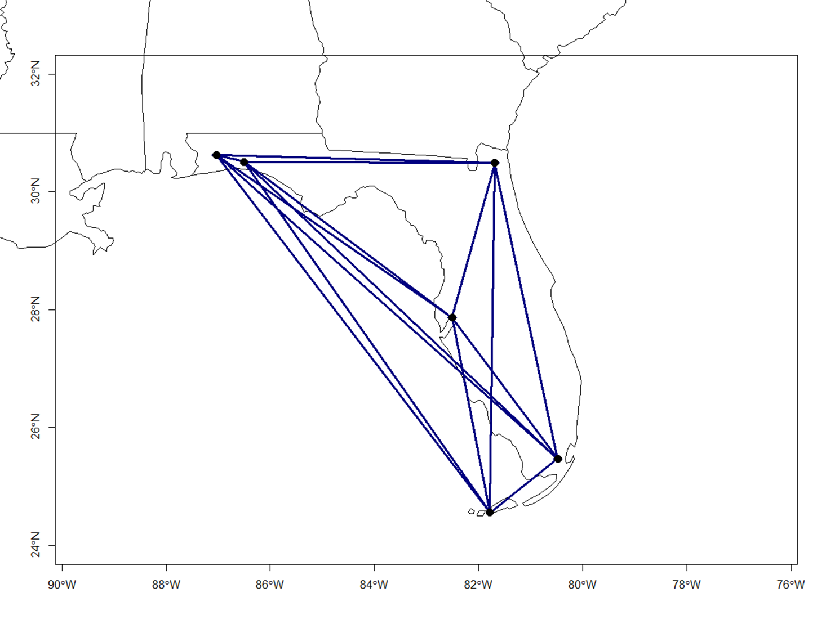
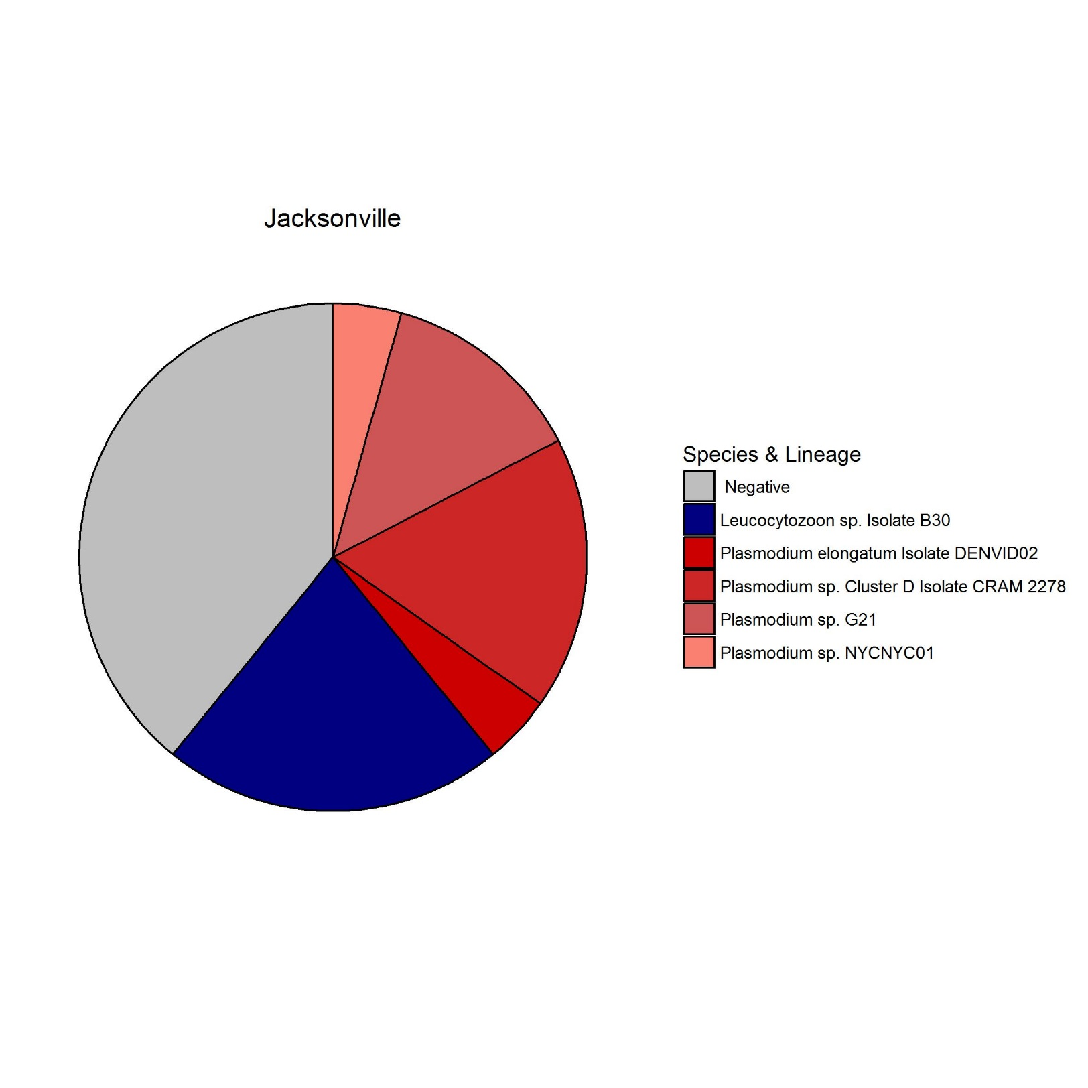
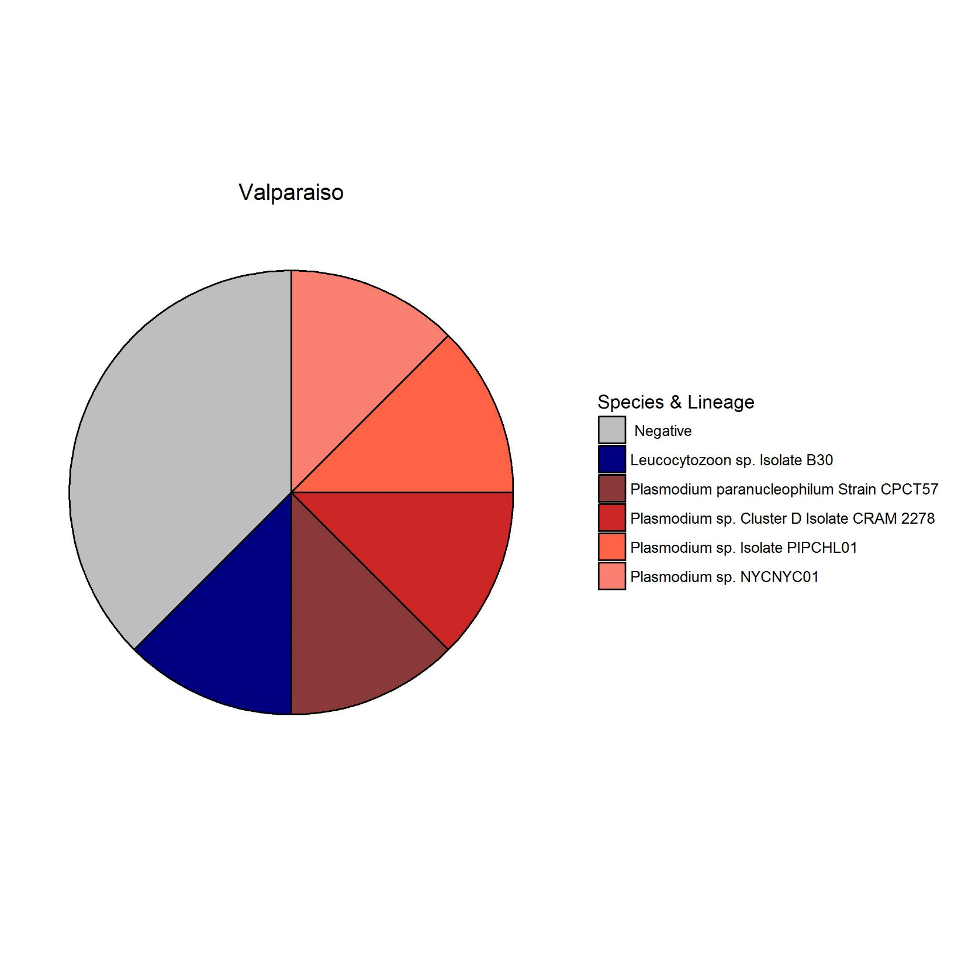
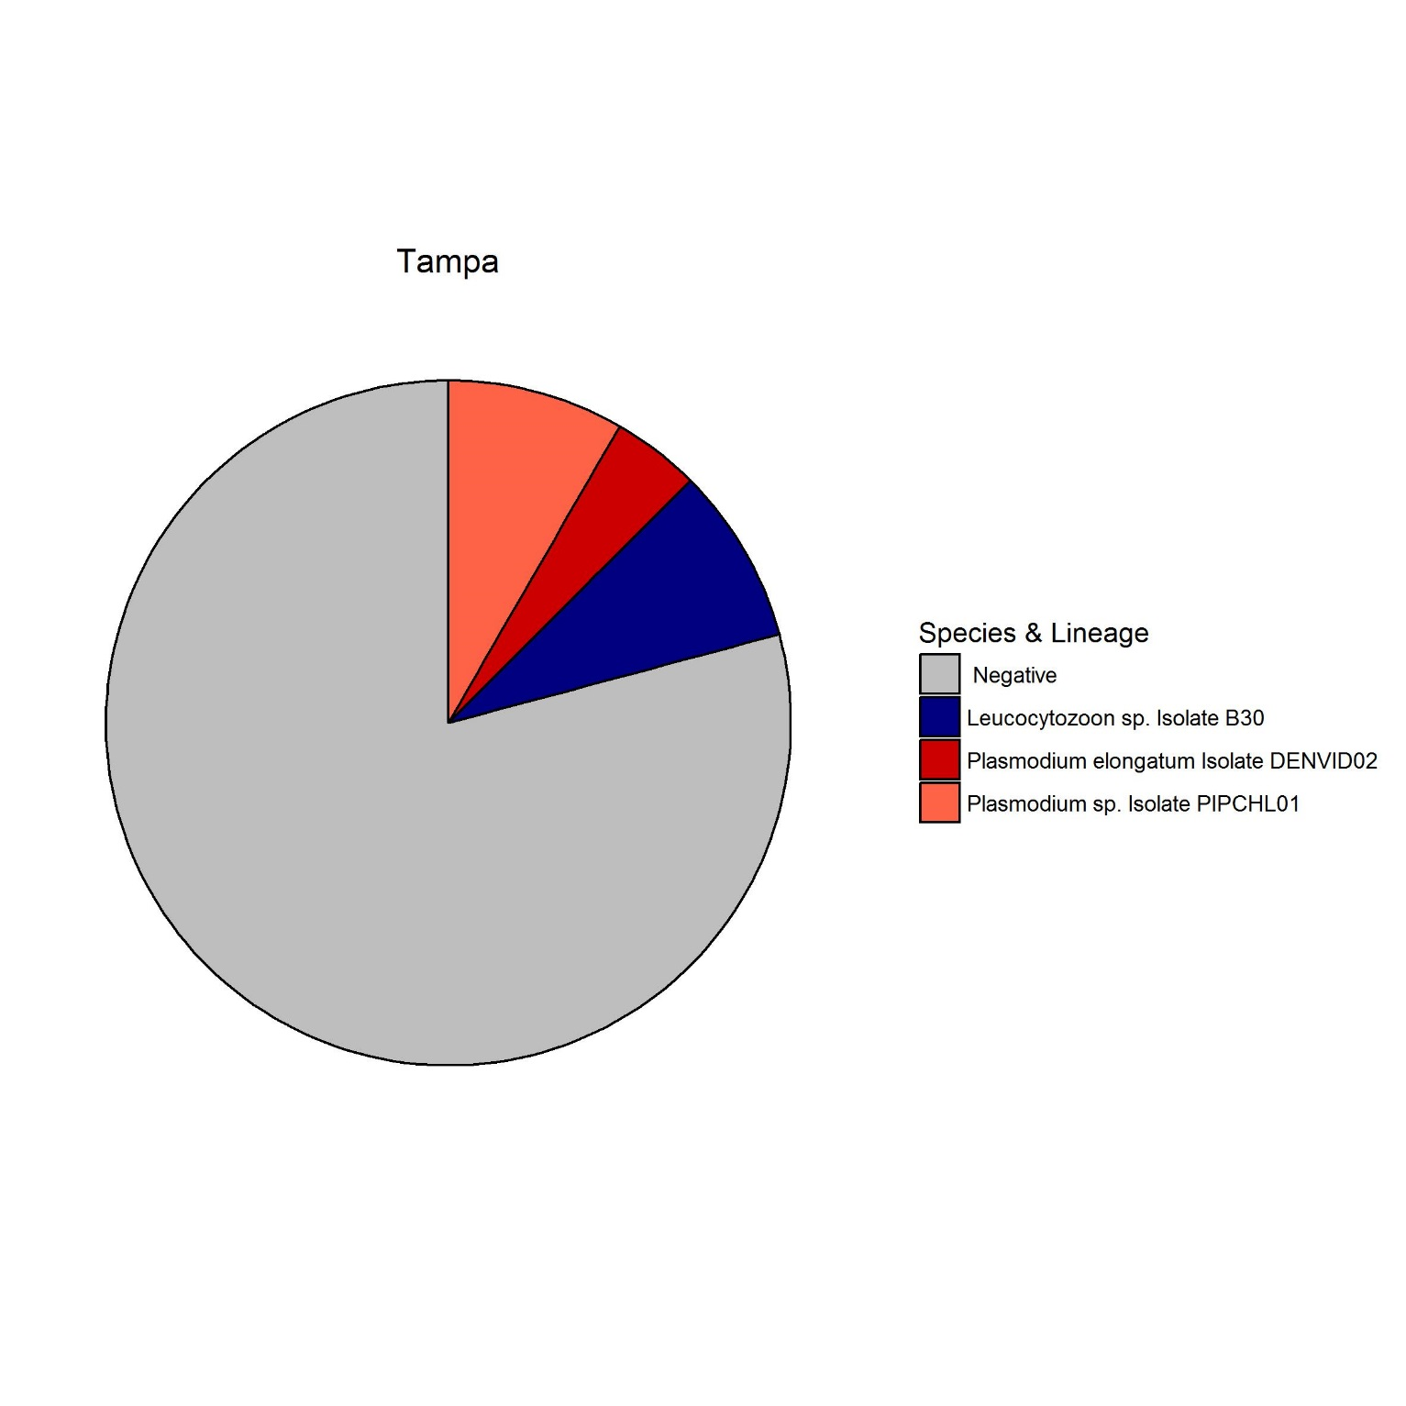
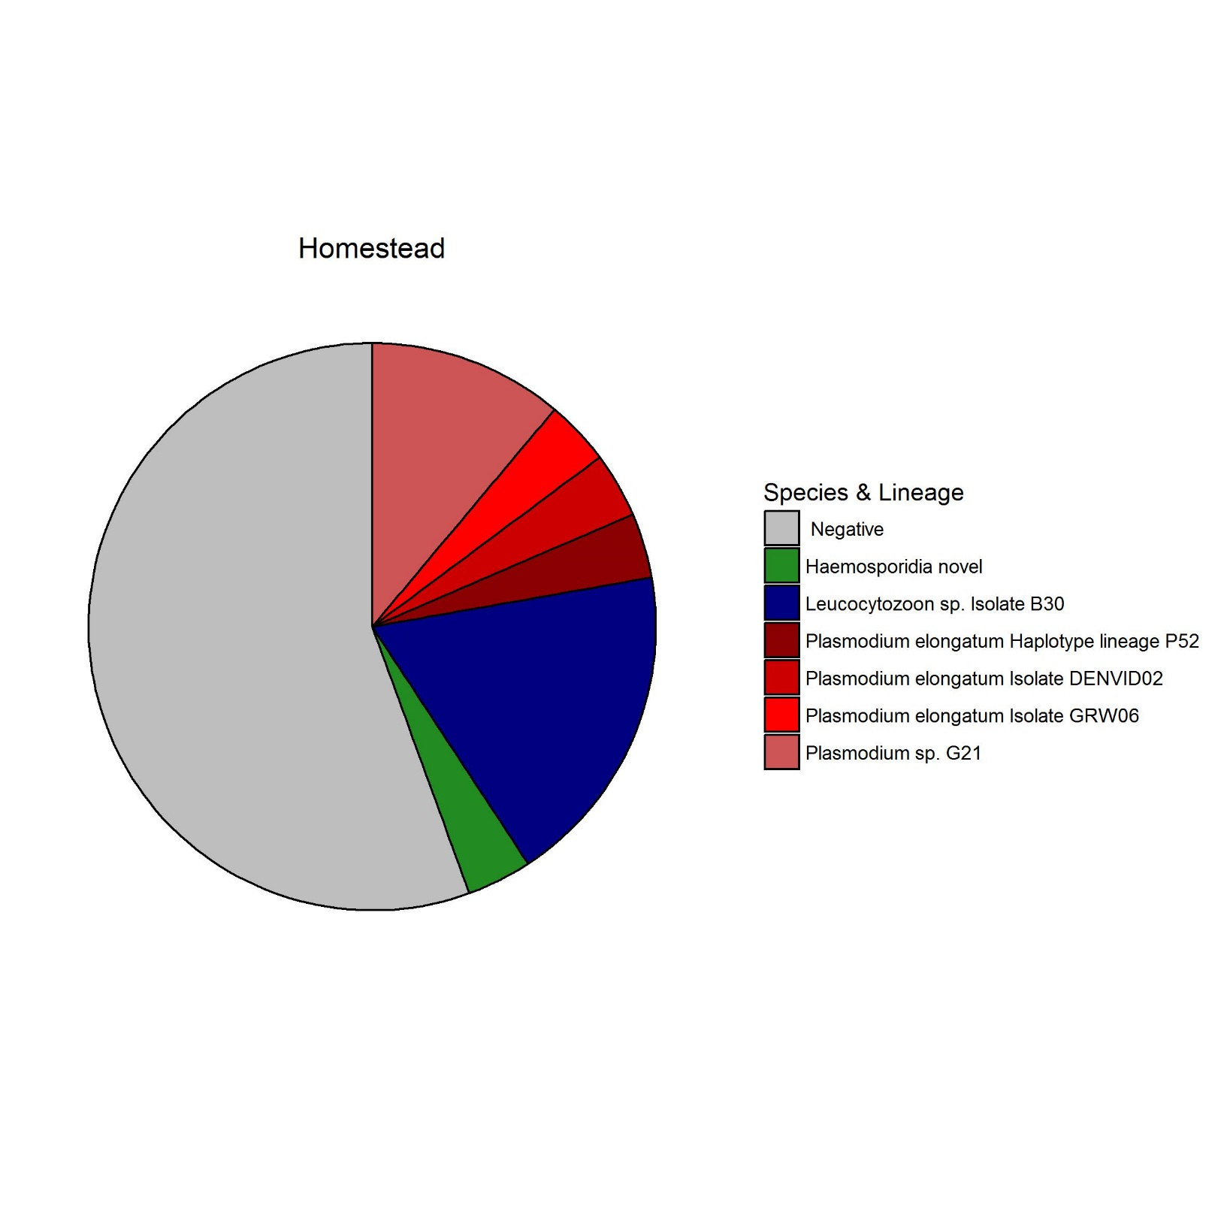
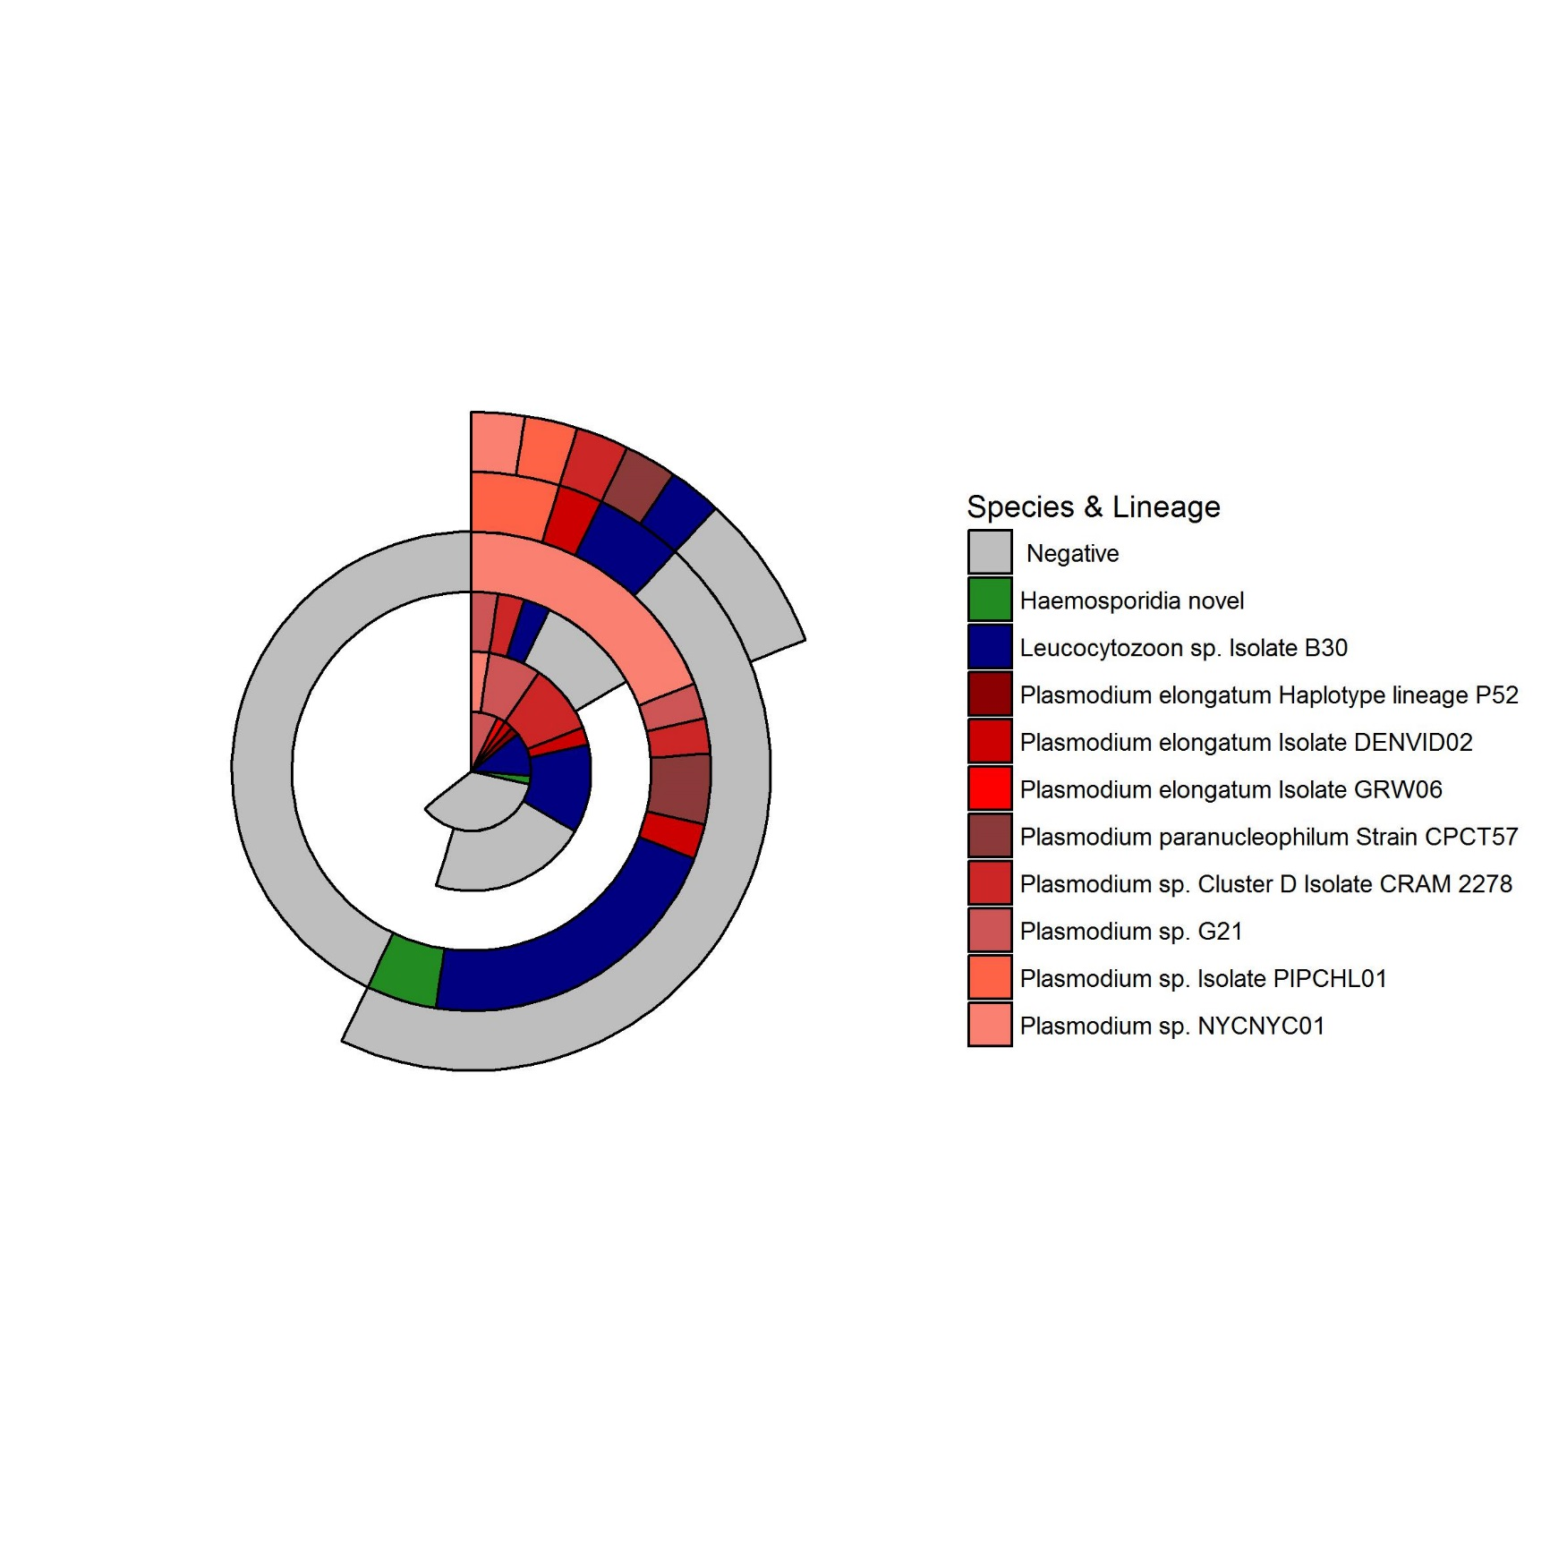
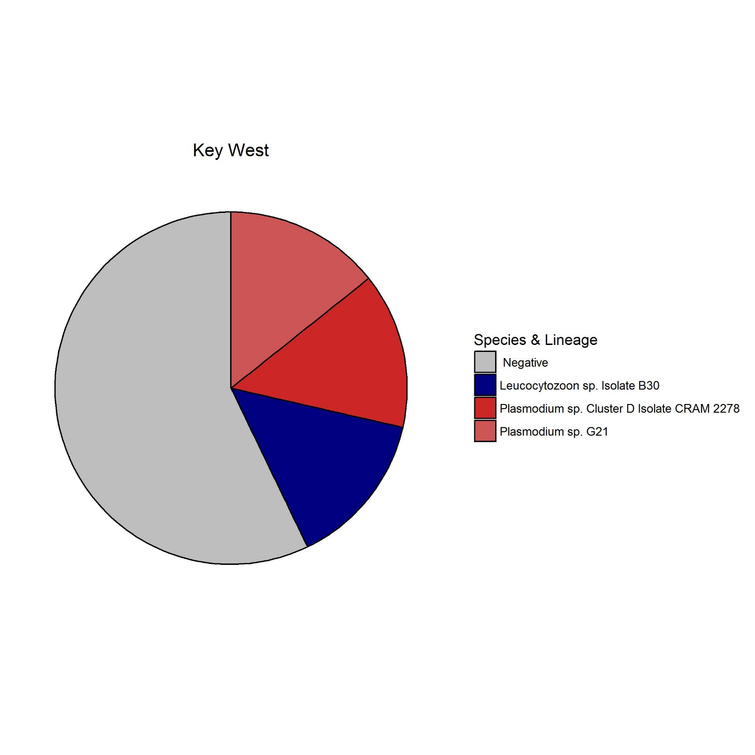
Spatial variation and biogeographical patterns of Haemosporidia in Florida Cattle Egret (Bubulcus ibis)
Phylogeny
Figure 1. Concensus tree of Avian Haemosporidia in Florida Cattle Egret based on cytochrome b gene. Concensus tree made with Geneious R10 Version 10.2.3. Divergent clade indicative of new Haemosporidia taxon. Both clades overall are very widespread, however, several smaller Plasmodium clades are only present in north Florida.
Shannon P. Moore¹, Kim Ledger¹, Emily Dinh²
¹ Department of Wildlife Ecology and Conservation, University of Florida, 32611; ²Department of Geography, University of Florida, 32611
Leucocytozoon
Background
Objectives
Avian Haemosporidia are widely distributed blood parasites transmitted by arthropod vectors and their avian hosts, and are the agent of avian malaria.
Avian Haemosporidia includes three genera: Plasmodium, Haemoproteus, Leucocytozoon. Each genera is vectored by a different arthropod.
Cattle Egret are a migratory avian species with a rapidly expanding range. Little is known about the potential for Cattle Egret to transport pathogens across their range.
Present prevalence of Avian Malaria lineages in Cattle Egret across Florida
Measure connectivity of Avian Malaria in Cattle Egret across Florida
Vectors of Avian Haemosporidia
Methods
Plasmodium
Anopheles spp. (Mosquito) -> Plasmodium spp.
Culicoides spp. (Midge) -> Haemoproteus spp.
Simulium spp. (Black fly) -> Leucocytozoon spp.
Euthanized Cattle Egret were collected during routine airstrike prevention at airports
Muscle and spleen were collected during necropsy of Cattle Egret
DNA was extracted from spleen and screened for regions of the cytochrome b gene of the Haemosporidia mitochondrial DNA
Positive samples were determined with gel electrophoresis and sequenced using Sanger sequencing
Sequences processed using Geneious R10 Version 10.2.3.
Figure 2. Colors on phylogenetic tree correspond with Florida ecoregions. Labeled locations are sample sites.
Prevalence
Connectivity
Figure 3. Prevalence of species and lineages of Avian Malaria in Cattle Egret in Florida.
Leucocytozoon sp. Isolate B30 is wide spread
Plasmodium sp. NYCNYC01 only in central and northern Florida
Novel Haemosprodia genus found in both north and south
Prevalence of neighboring cities, Milton and Valparaiso varied
Pie charts and map made with ggplot2 package in
R version 3.4.1
Probability Matrix Map
Binary Matrix Map
Weighted Matrix Map
Plasmodium
N=42
Leucocytozoon
N=23
Figure 4: Genetic connectivity of Plasmodium and Leucocytozoon samples from Cattle egret at 6 sites in Florida, USA. The edges of the probability matrix maps represent all possible connections between sites. The edges of the binary matrix map represent connections between sites with sample of >99% identity. With the cytochrome b gene >99% identity indicates same species. The colors of the edges of the weighted matrix map scale to genetic connectivity of samples, with darker colors representing more closely related samples. Maps made with the igraph package in R version 3.4.1.
N=8
N=24
N=27
Conclusions
Identification of a potential new haemoparasite taxon that is divergent from Leucocytozoon
The large clade of Leucocytozoon is geographically widespread, as evident in both the phylogenetic tree, prevalence map, and the weighted matrix map
The Plasmodium clade is widespread, but the weighted matrix map indicates stronger connections between certain locations, emphasizing longer movements rather than shorter connections
Lack of Haemoproteus sp. may be due Cattle Egrets preference for grasslands and freshwater, rather than the salter water habitat of midges
N=7

